Slide 1
Ant Colony Optimization
BY:-
M.V.BHANU PRAKASH
08R81A0546

Slide 2

Contents
Introduction
Human Nature Relationship
Ant Communication
Analysis of Algorithm
Pseudo Code
Applications
Simple ex on TSP
What we have learnt??

Slide 3
Human Nature Relationship
We humans think we are the ultimate in all aspects but we too learn a lot from other living beings.
We depend for our food on plants and animals.
In terms of technology, we still perform some experiments on animals and obtain results.
In our topic we see what we have learnt from ants.

Slide 4
Introduction-Swarm Intelligence
Swarm intelligence (SI):-
Describes the collective behavior of decentralized,
self-organized systems, natural or artificial. The concept is employed in work on artificial intelligence
Swarming theory
Related to bird flocking, fish schooling
- steer toward the center
- match neighbors’ velocity
- avoid collisions

Slide 5
Swarm Intelligence
Origins in Artificial Life (Alife) Research
ALife studies how computational techniques can help when studying biological phenomena
ALife studies how biological techniques can help out with computational problems
Two main Swarm Intelligence based methods
Particle Swarm Optimization (PSO)
Ant Colony Optimization (ACO)

Slide 6
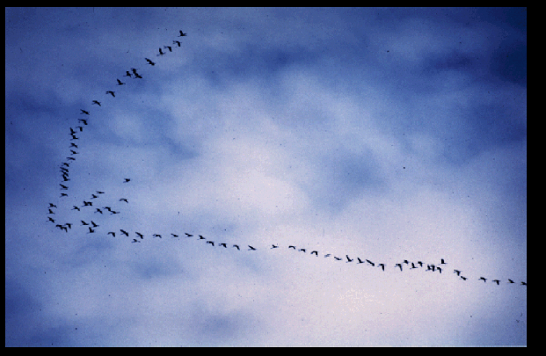
Bird Flocking

Slide 7
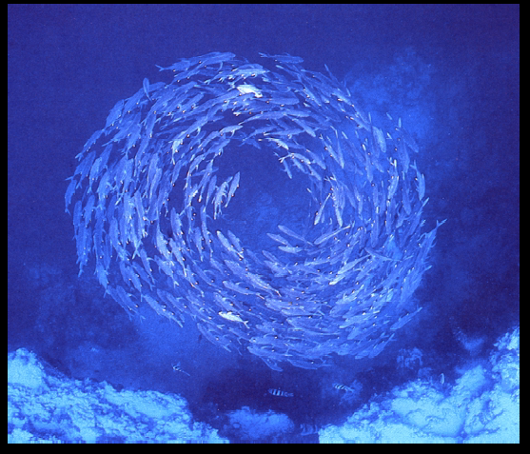
Fish Schooling

Slide 8
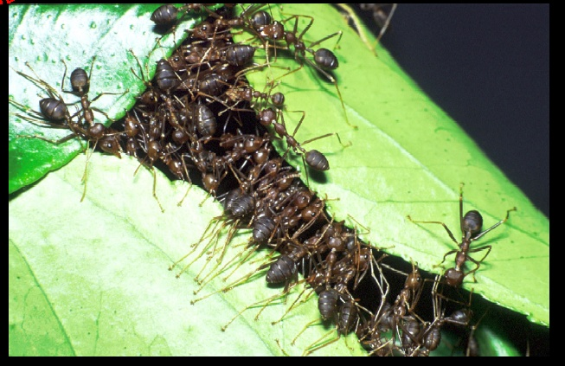
Ant Colony

Slide 9
ACO Concept
Ants (blind) navigate from nest to food source
Shortest path is discovered via pheromone trails
each ant moves at random
pheromone is deposited on path
ants detect lead ant’s path, inclined to follow
more pheromone on path increases probability of path being followed

Slide 10
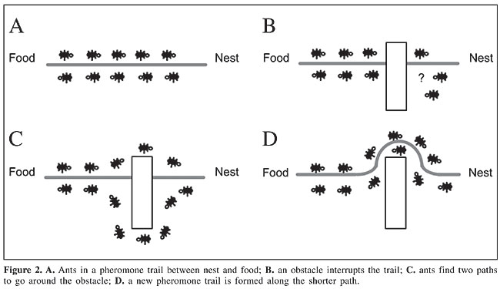
Ant Communication

Slide 11
Pheromone Trails

Slide 12
Pheromone Trails

Slide 13
Pheromone Trails

Slide 14
Pheromone Trails

Slide 15
Pheromone Trails

Slide 16
Pheromone Trails

Slide 17
Natural ants: How do they do it?
The pheromone concentration on trail B will increase at a higher rate than on A, and soon the ants on route A will choose to follow route B
Since most ants will no longer travel on route A, and since the pheromone is volatile, trail A will start evaporating
Only the shortest route will remain!
Since the route B is shorter, the ants on this path will complete the travel more times and thereby lay more pheromone over it.

Slide 18
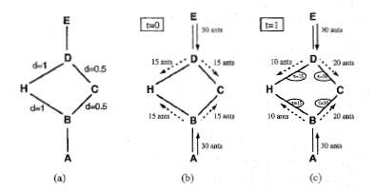
An example with artificial ants
(a) The initial graph with distances.
(b) At time t = 0 there is no trail on the graph edges.
(c) At time t = 1 trail is stronger on shorter edges.

Slide 19
Algorithm
1. {Initialization}
Initialize Ґiѱ and ῃѱ
2. {Construction}
For each ant k (currently in state i) do
repeat
choose in probability the state to move into.
append the chosen move to the k th ant's set tabuk.
until ant k has completed its solution.
end for
3. {Trail update}
For each ant move (iy ) do compute Dtiy
update the trail matrix.
end for
4. {Terminating condition}
If not (end test) go to step 2

Slide 20
Flowchart of ACO
START ACO
Locate ants randomly
in cities across the
grid and store the
current city
in a tabu list
Have the
maximum
Iterations been
performed
NO
YES
STOP
ACO
Determine probabilistically
as to which city to visit next
NO
Determine the shortest
tour till now and
update pheromone
Have all
cities been
visited
Move to next city and
place this city in the
tabu list
Record the length of
tour and clear tabu list

Slide 21

Analysis of Algorithm
An ant will move from node i to node j with probability:
Where
τ_{i,j} is the amount of pheromone on edge i,j
α is a parameter to control the influence of τ_{i,j}
η_{i,j} is the desirability of edge i,j (a priori knowledge, typically 1 / d_{i,j}, where d is the distance)
β is a parameter to control the influence of η_{i,j}

Slide 22

Pheromone Update:
Amount of pheromone is updated according to the equation:
τ_{i,j} = (1 − ρ)τ_{i,j} + Δτ_{i,j}
where
τ_{i,j} is the amount of pheromone on a given edge i,j
ρ is the rate of pheromone evaporation
Δτ_{i,j} is the amount of pheromone deposited, typically given by
where
L_{k} is the cost of the kth ant's tour (typically length).

Slide 23
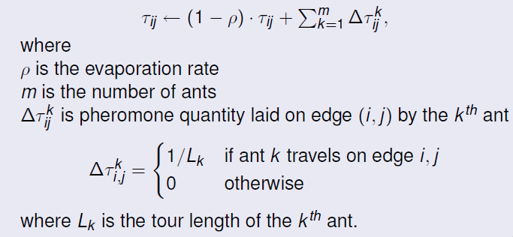
Updating the pheromone
Pheromone values are updated by all the ants that have completed the tour.

Slide 24
Pseudo Code
procedure ACO_MetaHeuristic
while(not_termination)
generateSolutions()
daemonActions()
pheromoneUpdate()
end while
end procedure

Slide 25
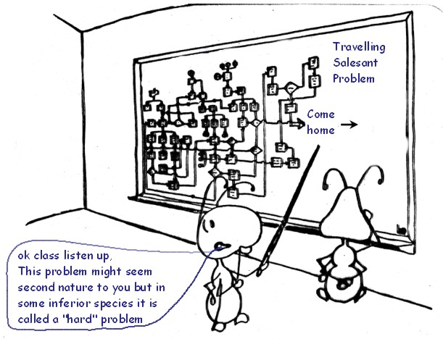
Simple example on TSP
T
S
P
U
S
I
N
G
A
C
O

Slide 26

A simple TSP example
[]
1
[]
A
B
2
[]
C
3
[]
4
D
E
[]
d_{AB} =100;d_{BC} = 60…;d_{DE} =150
5

Slide 27
Iteration 1
[A]
[B]
1
A
2
B
[C]
3
C
[D]
[E]
D
5
4
E

Slide 28
How to build next sub-solution?
[A]
1
A
B
[A]
1
[A]
C
1
[A,D]
[A]
1
1
D
E

Slide 29
Iteration 2
[E,A]
[C,B]
5
A
3
B
[B,C]
2
C
[A,D]
[D,E]
1
D
4
E

Slide 30
Iteration 3
[D,E,A]
[E,A,B]
4
5
A
B
[A,D,C]
1
C
[B,C,D]
[C,B,E]
2
D
3
E

Slide 31
Iteration 4
[B,C,D,A]
[D,E,A,B]
2
A
4
B
[E,A,B,C]
5
C
[C,B,E,D]
[A,DCE]
D
3
1
E

Slide 32
Iteration 5
[C,B,E,D,A]
[A,D,C,E,B]
3
1
A
B
[D,E,A,B,C]
4
C
[E,A,B,C,D]
[B,C,D,A,E]
D
5
E
2

Slide 33
Path and Pheromone Evaluation
[A,D,C,E,B]
L₁ =300
1
[B,C,D,A,E]
L₂ =450
2
[C,B,E,D,A]
L₃ =260
3
[D,E,A,B,C]
L₄ =280
4
[E,A,B,C,D]
L₅ =420
5

Slide 34
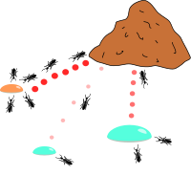
Applications
Vehicle routing problems
Connection-oriented
network routing
Image processing
Power Electronic Circuit Design
Discounted cash flows in project scheduling
Travelling Salesman Problem

Slide 35
Some inherent advantages
Positive Feedback accounts for rapid discovery of good solutions
Distributed computation avoids premature convergence
The greedy heuristic helps find acceptable solution in the early solution in the early stages of the search process.
The collective interaction of a population of agents.

Slide 36
Disadvantages in Ant Systems
Slower convergence than other Heuristics
Performed poorly for TSP problems larger than 75 cities.
No centralized processor to guide the AS towards good solutions

Slide 37
What we have learnt??
Idea about ant colony systems
Relationship between man and other living beings is thus highlighted in this topic.
We learnt from ants, the optimization of the path using their communication.
Many problems in our present day like sales man and others are easily solved by this optimization technique.

Slide 38
Conclusions
ACO is a recently proposed metaheuristic approach for solving hard combinatorial optimization problems.
Artificial ants implement a randomized construction heuristic which makes probabilistic decisions.
The a cumulated search experience is taken into account by the adaptation of the pheromone trail.
ACO Shows great performance with the “ill-structured” problems like network routing.
In ACO Local search is extremely important to obtain good results.

Slide 39
References
Dorigo M. and G. Di Caro (1999). The Ant Colony Optimization Meta-Heuristic. In D. Corne, M. Dorigo and F. Glover, editors, New Ideas in Optimization, McGraw-Hill, 11-32.
M. Dorigo and L. M. Gambardella. Ant colonies for the traveling salesman problem. BioSystems, 43:73–81, 1997.
M. Dorigo and L. M. Gambardella. Ant Colony System: A cooperative learning approach to the traveling salesman problem. IEEE Transactions on Evolutionary Computation, 1(1):53–66, 1997.
G. Di Caro and M. Dorigo. Mobile agents for adaptive routing. In H. El-Rewini, editor, Proceedings of the 31st International Conference on System Sciences (HICSS-31), pages 74–83. IEEE Computer Society Press, Los Alamitos, CA, 1998.
M. Dorigo, V. Maniezzo, and A. Colorni. The Ant System: An autocatalytic optimizing process. Technical Report 91-016 Revised, Dipartimento di Elettronica,Politecnico di Milano, Italy, 1991.
L. M. Gambardella, ` E. D. Taillard, and G. Agazzi. MACS-VRPTW: A multiple ant colony system for vehicle routing problems with time windows. In D. Corne, M. Dorigo, and F. Glover, editors, New Ideas in Optimization, pages 63–76. McGraw Hill, London, UK, 1999.
L. M. Gambardella, ` E. D. Taillard, and M. Dorigo. Ant colonies for the quadratic assignment problem. Journal of the Operational Research Society,50(2):167–176, 1999.
V. Maniezzo and A. Colorni. The Ant System applied to the quadratic assignment problem. IEEE Transactions on Data and Knowledge Engineering, 11(5):769–778, 1999.
Gambardella L. M., E. Taillard and M. Dorigo (1999). Ant Colonies for the Quadratic Assignment Problem. Journal of the Operational Research Society, 50:167-176.

Slide 40

Questions ?

Slide 41
Thank You

